Slide 1
DIGITAL DESIGN & COMPUTER ARCHITECTURE
MULTI-BIT BINARY
ADDER & SUBTRACTOR
OPERATION SELECT
M = 0
ADD
M = 1
SUBTRACT
A 4-bit arithmetic circuit using full adders, XOR gates and mode control
A + B / A − B
TEAM MEMBERS
SECTION: __________
SUBJECT: DDCA
Bhuvana | 2620030052
M. Harshithaa Reddyy | 2620030118
Nishitha | 2620030113
Sai Kiran | 2620030061
FINAL PROJECT DEMONSTRATION

Slide 2
DDCA / 02
Introduction & Objective
One circuit. Two arithmetic operations.
WHY BINARY ARITHMETIC?
PROJECT OBJECTIVE
•
Digital systems represent data using 0s and 1s.
Design and simulate a 4-bit circuit that adds or subtracts two binary inputs.
•
Arithmetic circuits are used inside processors and ALUs.
M = 0
A + B
M = 1
A − B
•
A shared design performs addition and subtraction.
Outputs: S3–S0 (4-bit result) and final carry-out.

Slide 3
DDCA / 03
Theory & Logic Circuit
XOR gates conditionally invert B; full adders calculate the result.
4-BIT RIPPLE-CARRY ADDER–SUBTRACTOR
ADDITION MODE
M
M = 0 → B′ = B, C₀ = 0
XOR 3
XOR 2
XOR 1
XOR 0
A3, B3
A2, B2
A1, B1
A0, B0
SUBTRACTION MODE
FULL
ADDER 3
C2
FULL
ADDER 2
C1
FULL
ADDER 1
C0
FULL
ADDER 0
M = 1 → B′ = NOT B, C₀ = 1
B′ = B XOR M
C₀ = M
S3
S2
S1
S0
Four full adders are linked by carry signals. M controls all XOR gates and C₀.

Slide 4
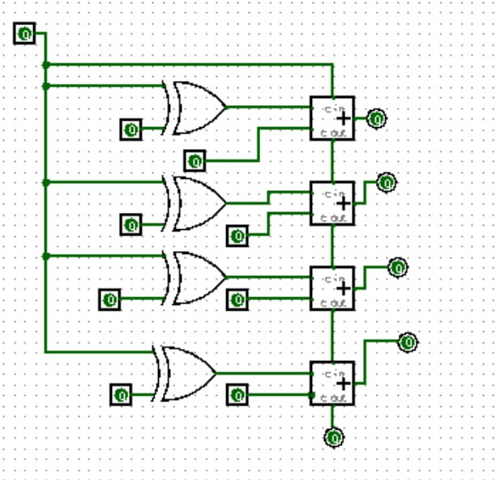
DDCA / 04
Circuit Design in Logisim
Use this schematic as a guide; replace it with your actual Logisim screenshot before submission.
LOGIC CIRCUIT OVERVIEW (ILLUSTRATION)

Slide 5
DDCA / 05
Simulation Results
Expected test cases — verify in Logisim and insert real screenshots.
TEST 1 / ADDITION
TEST 2 / SUBTRACTION
A = 0101 B = 0011 M = 0
A = 0111 B = 0011 M = 1
Expected result: 1000 (5 + 3 = 8)
Expected result: 0100 (7 − 3 = 4)
RESULTS TABLE
Test
A
B
M / Mode
Expected
Observed
1
0101
0011
0 / Add
1000
Fill after test
2
0111
0011
1 / Sub
0100
Fill after test
Do not label expected values as observed results until you have tested the circuit.

Slide 6
DDCA / 06
Conclusion & Applications
A compact arithmetic building block for digital systems.
KEY TAKEAWAYS
APPLICATIONS
•
One circuit supports addition and subtraction.
ALUs
Arithmetic in processors
•
XOR gates and mode control enable two’s-complement subtraction.
Calculators
Basic binary operations
•
Ripple-carry designs are simple but can have propagation delay.
Embedded systems
Digital control and computation
•
Possible improvement: a carry-lookahead design.
THANK YOU

